Slide 1



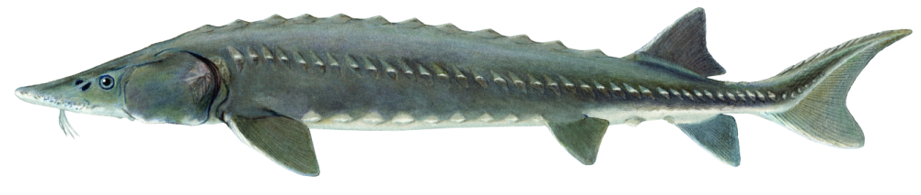
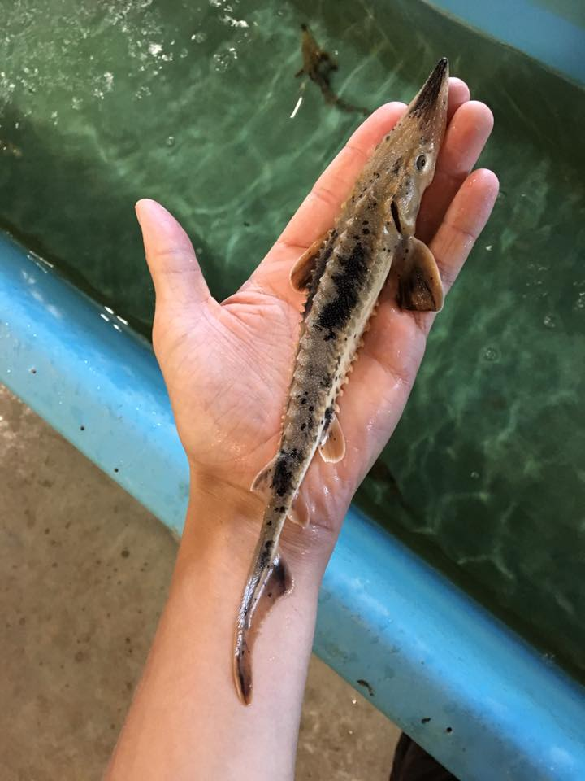
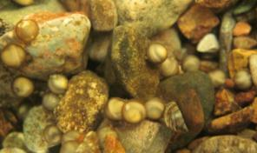
Michigan State University
Lesson 3
Egg Deposition, Development, and Survival
Photo Credit: Stefan Tucker
John Bauman, Doug Larson and Kim Scribner
Department of Fisheries and Wildlife
Michigan State University

Slide 2
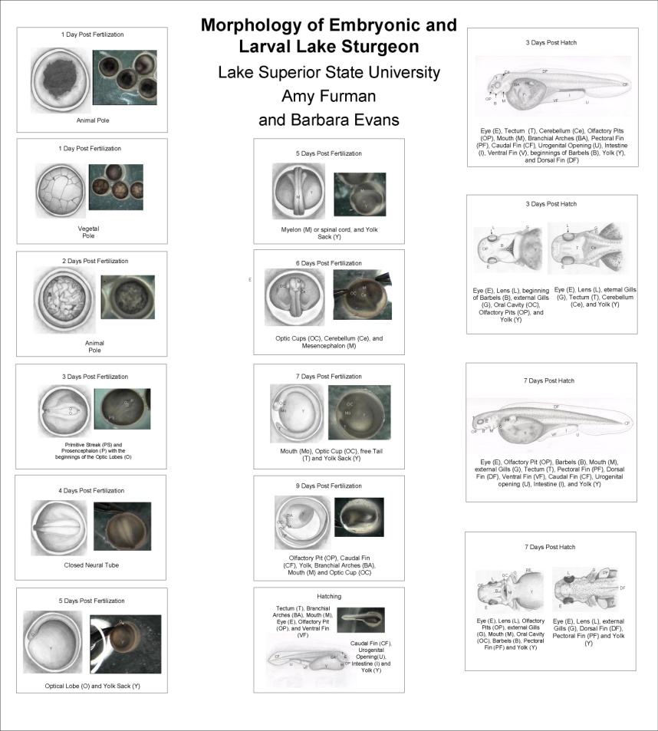
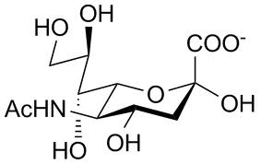
Michigan State University
Egg Period Ecology
Lake Sturgeon Egg Deposition - Background
Lake sturgeon are “Lithophilic spawners” which means during spawning, eggs are broadcast into rock crevices on the river bottom. Once in contact with water, a sialic acid chemical reaction creates an adhesive property, which allows eggs to become ‘sticky’ and adhere to rocks during incubation.
Spawning adults neither build a nest for cover, nor care for the developing offspring during this life period. Hatching may take 5-10 days dependent upon water temperature. Typically, eggs that incubate in colder temperatures take several days longer to hatch than those incubated in warmer temperatures.
During the egg period, developing lake sturgeon are vulnerable to a host of potential predators that inhabit Great Lakes tributaries where sturgeon eggs are laid. Recent studies have shown that predators such as Rusty Crayfish (O. rusticus), Round Goby (N. melanostomus) prey on lake sturgeon eggs. Also, there are microbes and fungi that attack developing embryos and feed off of dead or decaying lake sturgeon eggs.
3 mm
Sialic acid

Slide 3
Michigan State University
Lake Sturgeon broadcast eggs into the water column without constructing a nest, thus eggs are distributed in the current downstream for considerable distances. Water depth, substrate, and water velocity predict the number of eggs deposited down stream of a spawning event. In the figure, you can see that the number of eggs is not evenly distributed across or down the stream. Note the difference in egg number between day 1 and day 3 following spawning indicating the magnitude of mortality during this life stage.
1
Day 1
2
3
4
Day 3
Spawning locations
Egg Deposition and loss

Slide 4
Michigan State University
Incubation time for lake sturgeon eggs varies as a function of water temperature
Egg development time to hatch varies as a function of the water temperature during incubation. Eggs from females spawning early in the spawning season in colder water (8-10ºC) take much longer times to hatch (10-14 days) compared to eggs from females that spawn later in the spawning season when water temperatures are 16-18ºC (5-7 days).

Slide 5
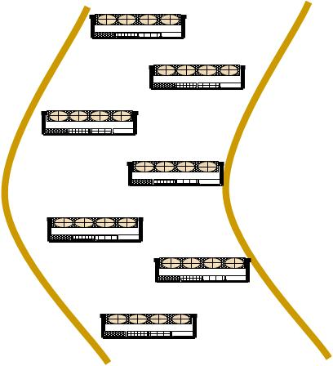
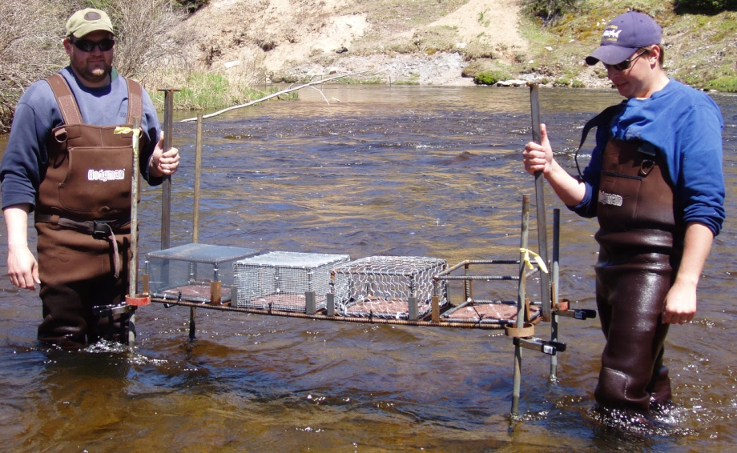
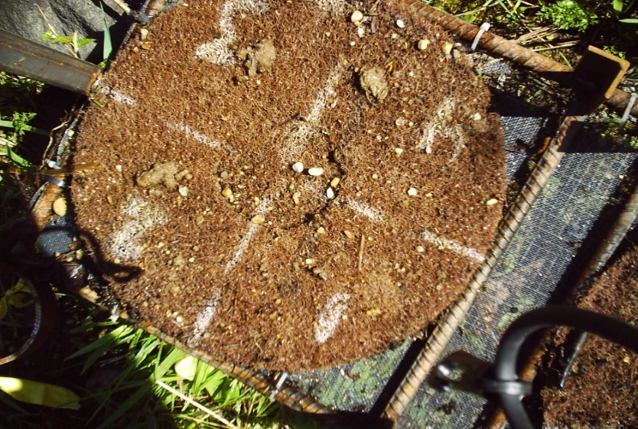
Michigan State University
Methods used to determine levels of egg mortality and sources of mortality
We placed fertilized eggs onto pads and placed pads into metal racks that were divided into 4 sections that differed in the size of wire mesh. Smaller mess sizes would keep out predators. However, smaller mess sizes would also reduce water flow. Thus the experiment evaluated the relative importance of predation (biotic effect) from environmental effects (flow).

Slide 6
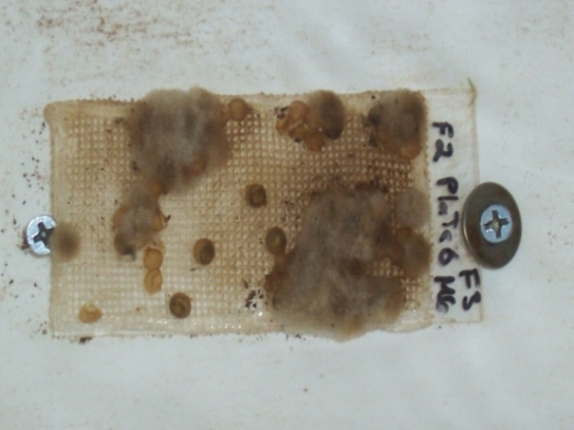
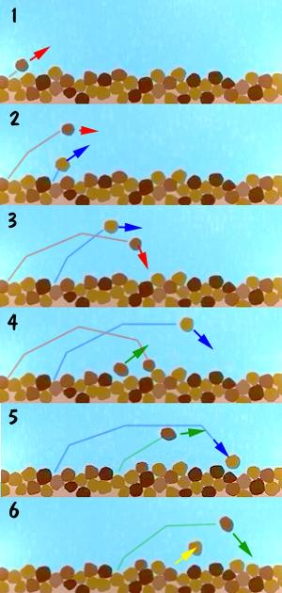
Michigan State University
Results of stream experiment on egg mortality
Egg loss attributed to developmental failure and to predation and de-adhesion for the pads in each cage varied among cages with different mesh size. Developmental failure was higher in cages with smaller screen mesh due to lower water velocity. Predation rates were higher in cages surrounded by screen of larger mesh size.
A) Developmental failure
B) Loss due to predation and
de-dadhesion
84%
16%
Time since fertilization (hrs)
Time since fertilization (hrs)

Slide 7
Michigan State University
Results – Egg Mortality
General:
Loss was time- dependent (P < 0.001)
Rate of loss was treatment dependent (P < 0.001)
No difference after 120 hrs
Average: 91% mortality
Range: 75-97%
Time since fertilization (hrs)

Slide 8
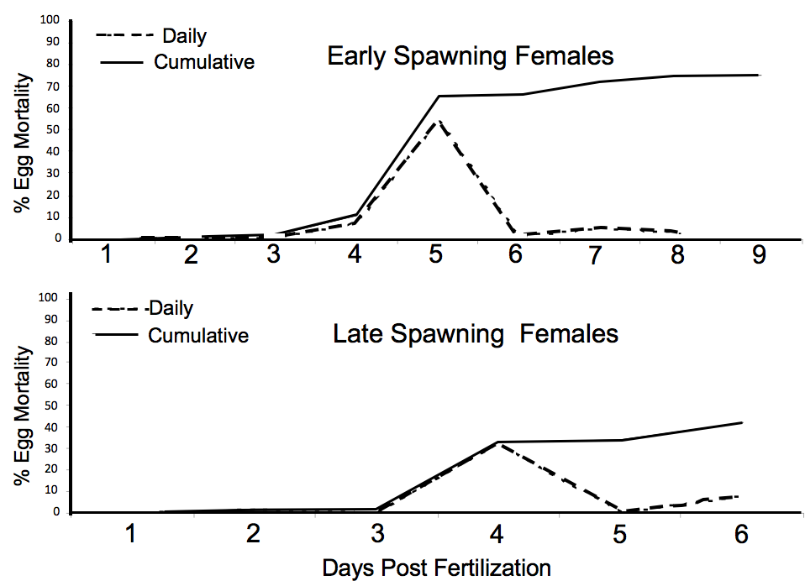
Michigan State University
Egg mortality as a function of egg development time for eggs incubated in cold (10-12C) and warm (16-18C) water.
Even in hatchery settings egg mortality
can be quite high. Incubation time is
dependent on water temperature. Eggs
take longer to hatch at colder temperatures.
The majority of the mortality occurs at the
end of the first trimester of incubation

Slide 9

Michigan State University
Experimental studies of lake sturgeon egg predation at the Black River Stream-side Facility
A large number of predators consume
lake sturgeon eggs. One of the biggest
predators may be invasive species such
as the rusty crayfish that is very common
in many Great Lakes tributaries. Results
from an experiment conducted at Black Lake
showed that egg loss increased as a function
of the number (density) of crayfish increased
regardless of the substrate.

Slide 10
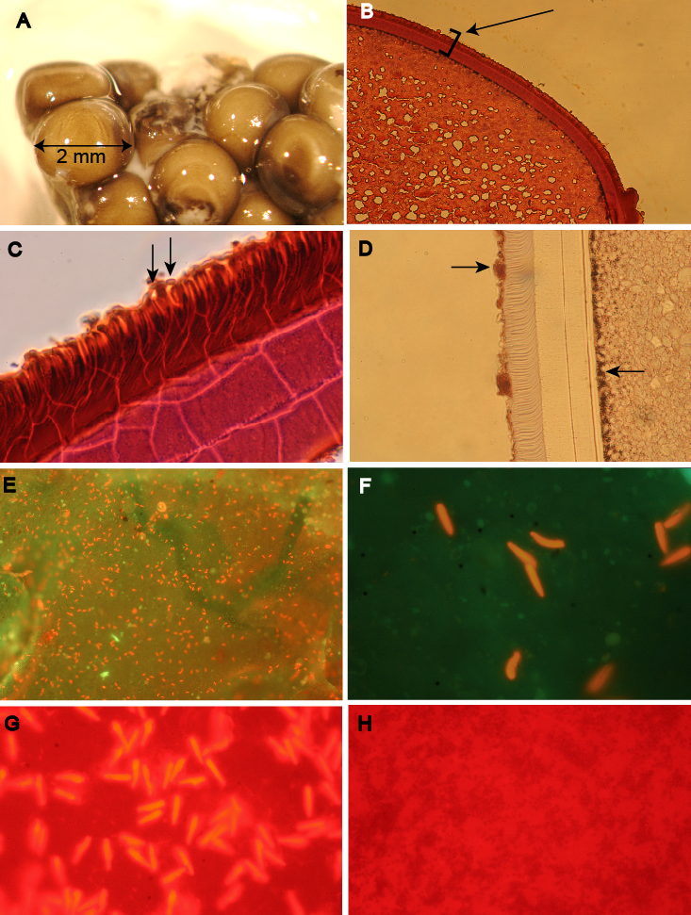
Michigan State University
Stream microbial populations are a major source of egg mortality
General features of sturgeon eggs colonized
by bacteria. Figure presents several images
of the sturgeon egg. Each egg is approximately 2
mm in diameter (Panel A). Panels B, C & D show
thin sections stained with Gram (B&C) and anti-
lysozyme (D). The chorion, a prominent structural
feature (arrow panel B) is covered by a microfibrous
outer layer (C) on which bacteria can be detected
(arrows). Panel D reveals lysozyme associated with
the outer microfibrous layer and the inner layer of the
chorion (dark brown staining material). Panels E
(400x) and F (1000x) are fluorescence images from
eggs exposed to stream. Evenly distributed bacteria
(fluorescent red) cover the outer layer. Panels G & H
show fluorescently stained (Live/Dead) whole eggs
that are captured after exposure to stream water
(G) or aseptically harvested from a gravid female
(H). The stream-exposed egg had a robust
community while aseptically harvested eggs
had no detectable bacteria on the surface.

